Slide 1
Cheap Eats
Ben Miller
Scott Sheffer
Christian Ford
Nathan Hall

Slide 2

What is our objective
To give an easy-to-read, easy-to-follow way for students to find the cheap/free food they never knew about
Offering a simple solution to both restaurants to host events and students to find those events
To help students communicate about events going on in campus in a food based environment

Slide 3
Why Cheap Eats?
To provide college students a much cheaper option to eat while on campus
To get students away from eating fast food every day and finding healthier options at a cheaper price
To create foot traffic and establish regular customers for restaurants by allowing them to advertise sales, post events, and notify their customers immediately.
To ultimately create an easier and cheaper solution for all parties involved

Slide 4
How We Plan to Create Cheap Eats
Created via an Android Application with the following components
Interface and System Services will be programmed in Java
Google Firebase will be used for the database
Android Studio will be the IDE
Testing will be done with JUnit as well as Google Firebases testing suite

Slide 5
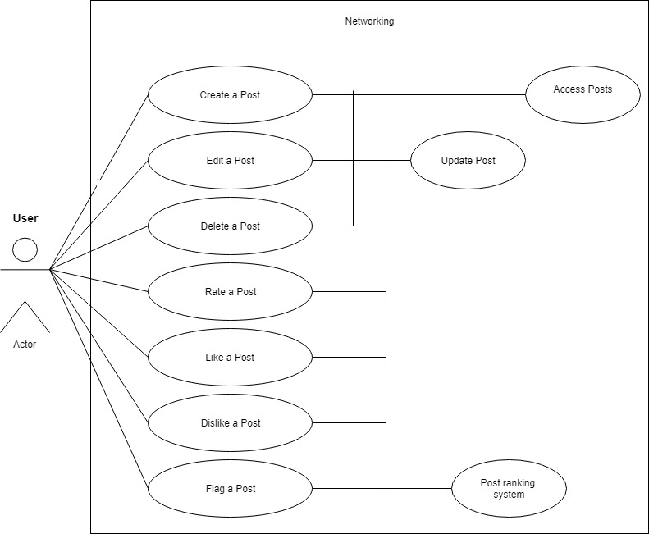
Use Cases
Register a New User
Login User
Set Food Preferences
Set Notification Preferences
Set Favorites
Search for Events
Filter Results
Browse Events
Create a Post
Edit a Post
Delete a Post
Rate a Post
Like a Post
Dislike a Post
Flag a Post
Get Directions
Block a Host or Event

Slide 6
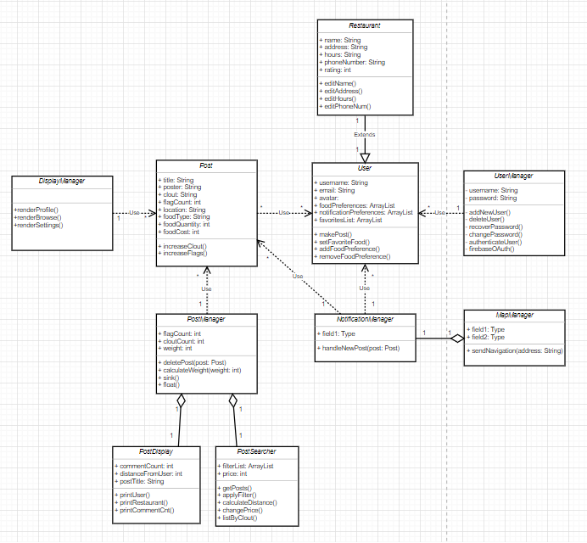
Class Diagram

Slide 7
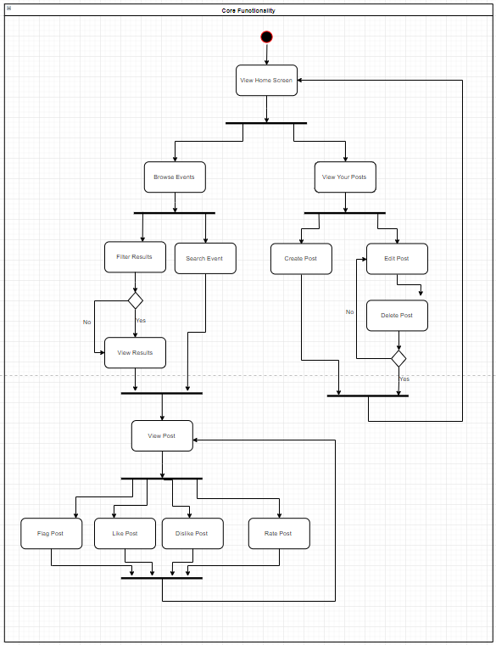
Core Functionality Activity Diagram

Slide 8
Questions?

